Slide 1



Symbolic Planning for Dynamic Robots
Laya Shamgah
Advisor: Dr. Karimoddini

Slide 2



TECHLAV Project
Testing, Evaluation and Control of Heterogeneous Large-scale Autonomous systems of Vehicles (TECHLAV)​
Thrust 1: Modeling, Analysis and Control of Large-scale Autonomous Vehicles (MACLAV)​
Task 1-5: Hierarchical Hybrid Cooperative Control of LSASV​

Slide 3
TECHLAV Project
Objective
Developing capable and scalable models for autonomous collaborative, robust and distributed decision-making, group coordination, planning, and tasking through effective interaction with human operators
Impact
Reaching higher levels of autonomy and teaming of multi-agent systems by using agents which are able to accomplish assigned missions autonomously and have the capability of autonomous collaboration with other teammates and human operators.

Slide 4
Relation to TECHLAV
Task 1-5: Hierarchical Hybrid Cooperative Control of LSASV
Hierarchical Control
Supervisory
Real-time control system
Planning
Rules and logics,…
Symbolic planning facilitates planning and coordination in a hierarchical control structure.
Control Design,…
Actuators,…

Slide 5
Outline
1
Robot Motion Planning and Control
2
5
Task Specification
3
Temporal Logic
4
Symbolic Planning
Future Work

Slide 6
Mobile Robots
Components
mechanical elements (wheels and gears)
electromechanical devices (motors, clutches and brakes)
digital circuits (processors and smart sensors)
software programs (embedded controllers)
Constraints
mechanical constraints (e.g., a car-like robot cannot move sideways)
limited energy resources, and computation, sensing, and communication capabilities.
Complexities
Environment is cluttered with possibly moving and shape changing obstacles.
Their objectives can change over time, such as in the case of appearing and disappearing targets.

Slide 7
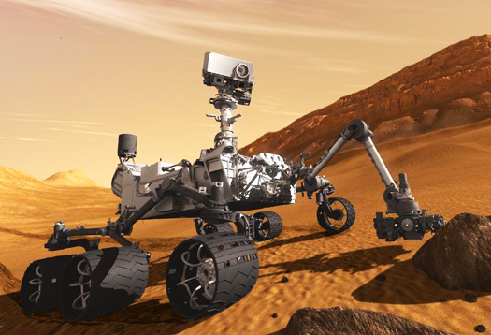
New Task Requirements for Robots
Converging to a desired operating point while always staying within a safe set
Executing sequenced tasks
Reaching certain areas and visiting certain areas infinitely often
Avoiding obstacles

Slide 8
Robot Motion Planning and Control
Problem
automatic construction of robot control strategies from task specifications given in high-level, human-like language
Challenge
the development of frameworks for control design which is:
computationally efficient
allowing for systematic, provably correct, control design
accommodating both the robot constraints and the complexity of the environment
allowing for expressive human-like task specifications

Slide 9
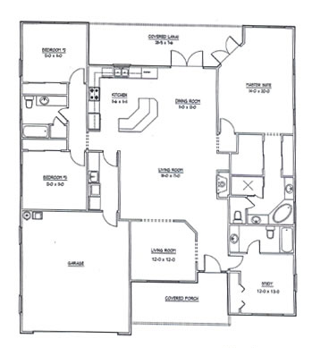
Task Planning
Mission requirements:
converging to a desired operating point while always staying within a safe set
executing sequenced tasks
reaching certain areas and visiting certain areas infinitely often
avoiding obstacles
How to formally describe the task?
Temporal logic

Slide 10
Why Temporal Logic?
A formal high level language to describe a complex mission
A wider class of properties than safety and stability
Having well defined syntax and semantics, which can be easily used to specify complex behavior

Slide 11
Introduction to Temporal Logic
Temporal logic:
Any system of rules and symbolism for representing, and reasoning about, propositions qualified in terms of time.
Classical logic:
Temporal logic
"I will be hungry until I eat something"
"I will eventually be hungry“
"I am always hungry“
“It is Monday”

Slide 12
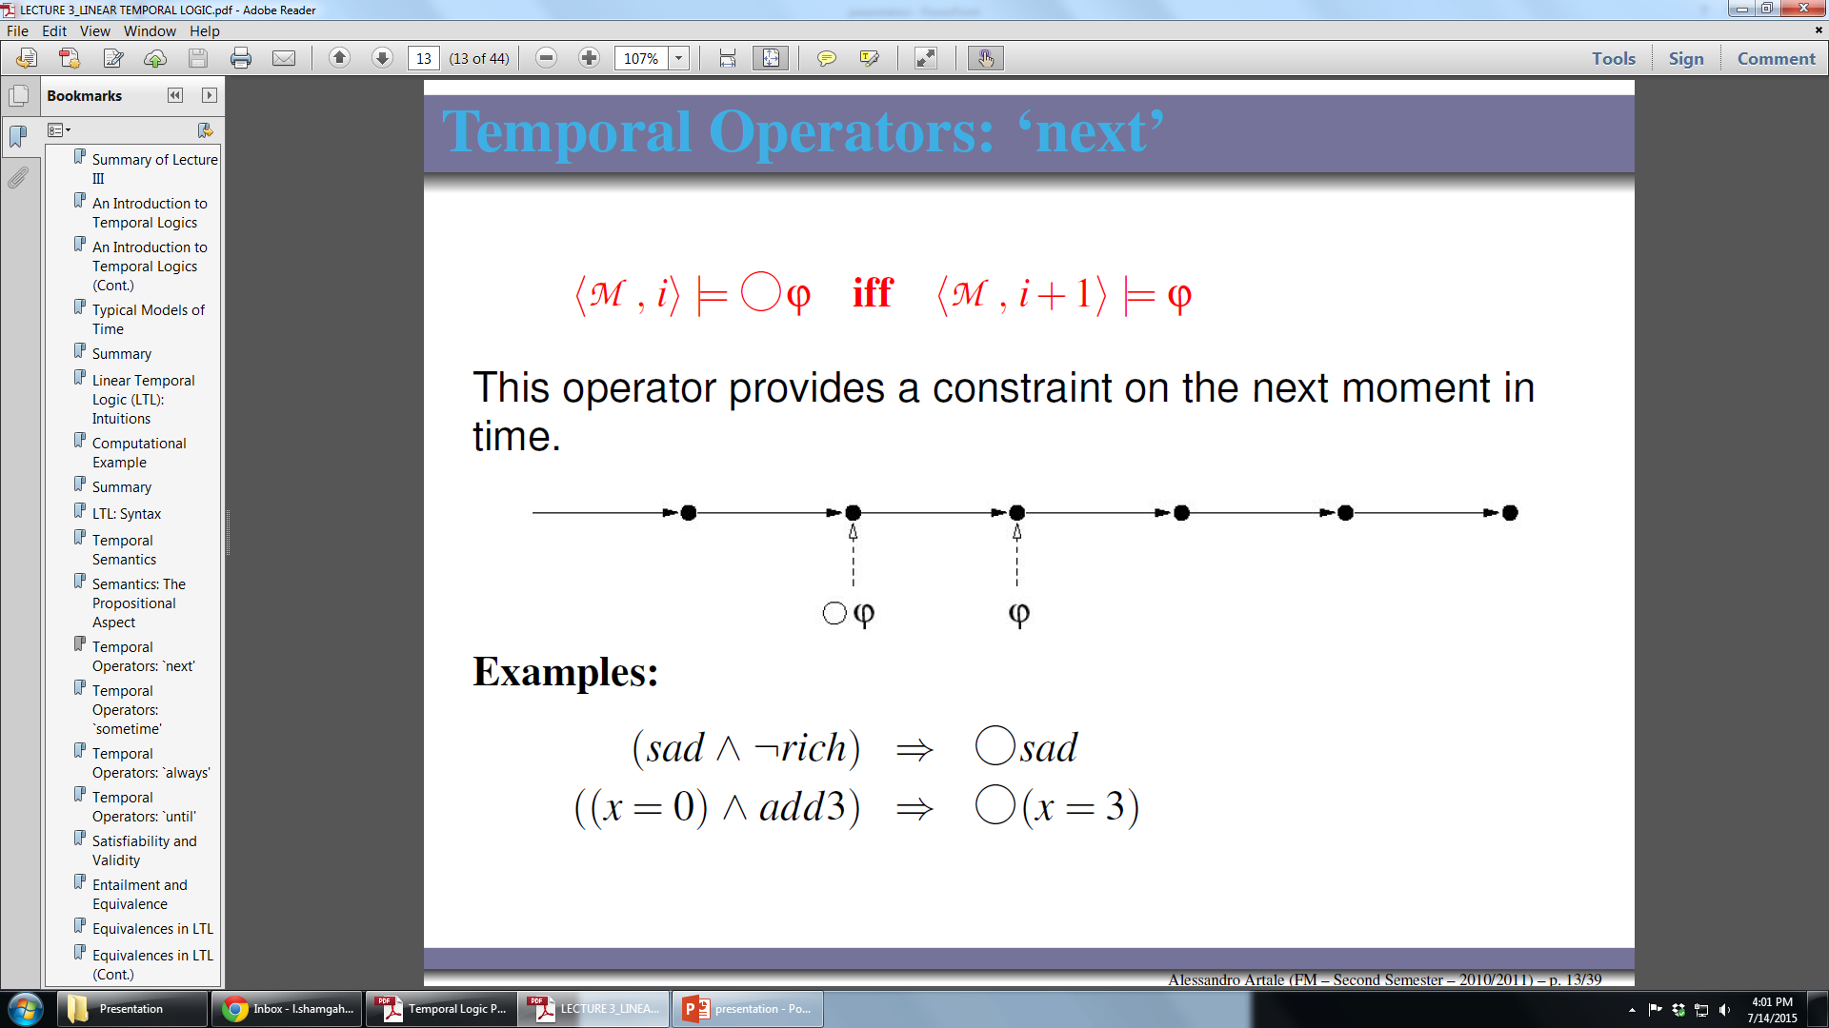
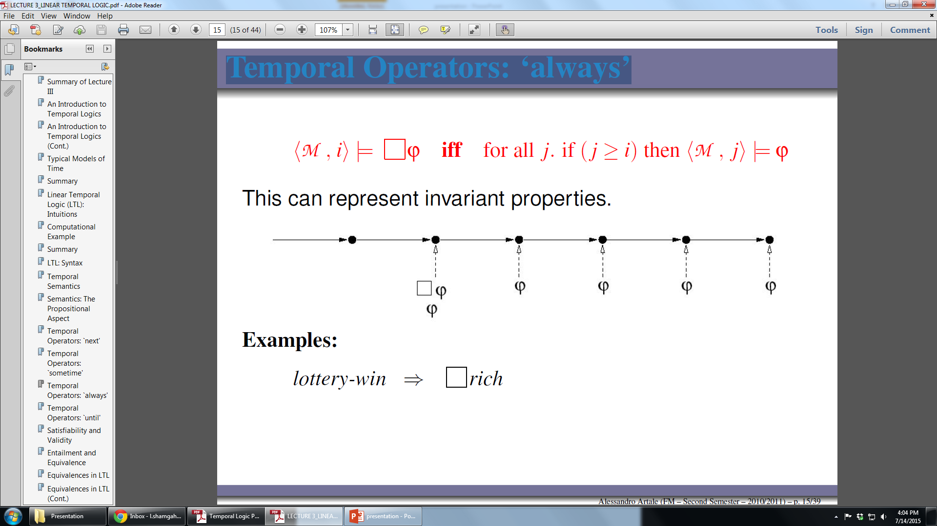
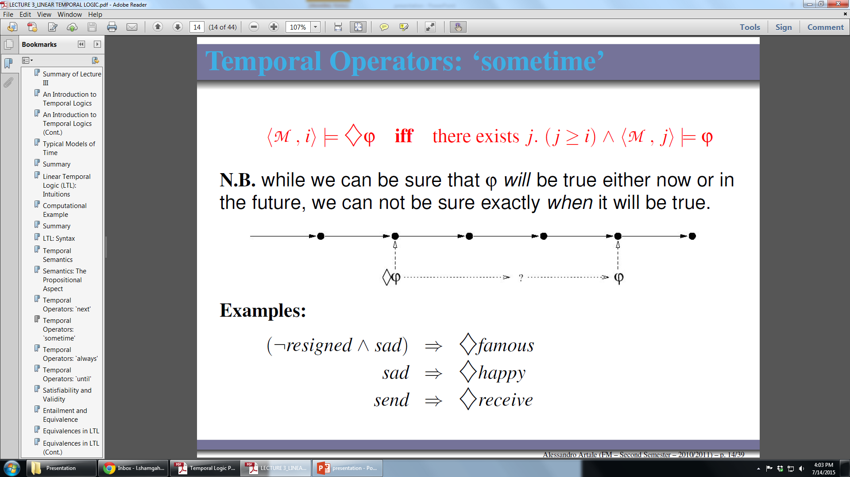
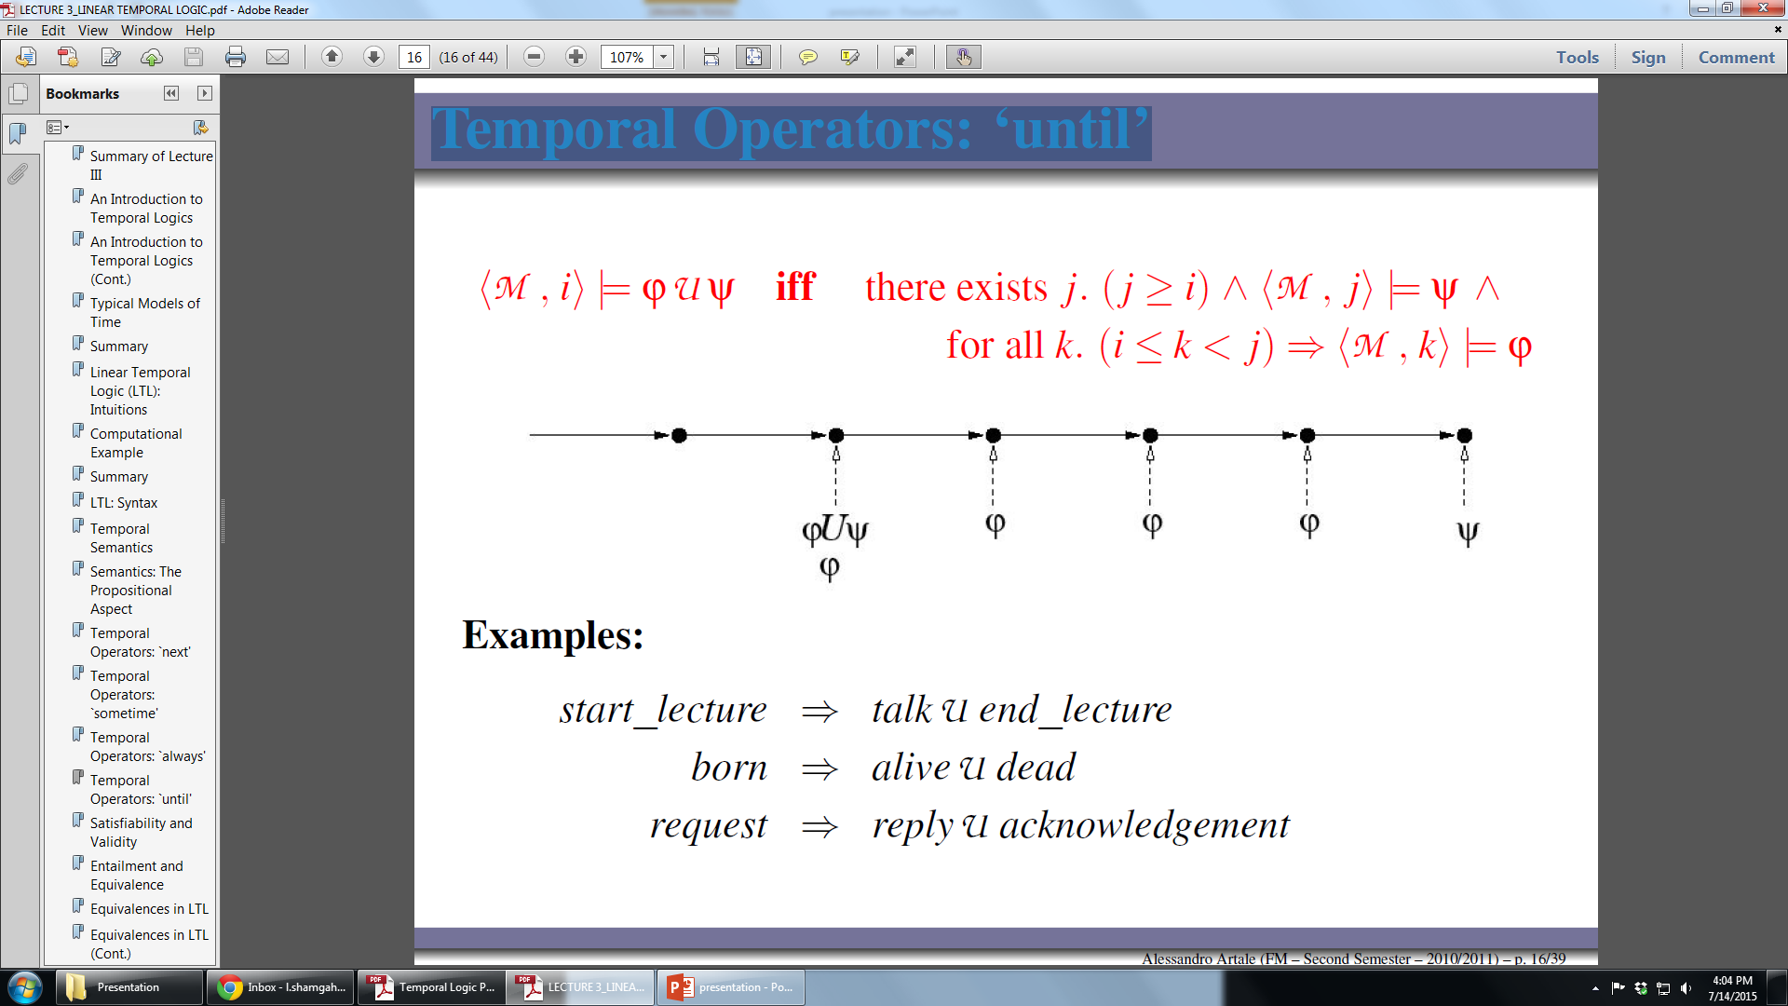
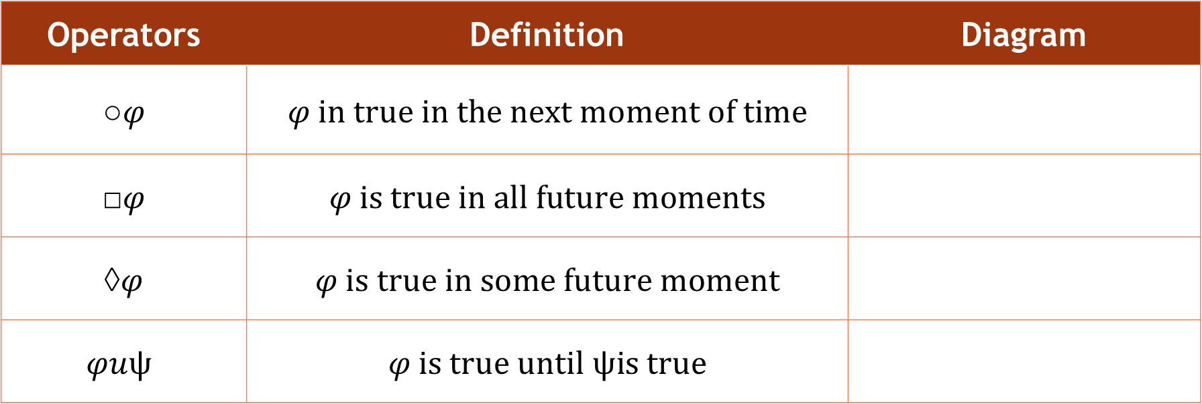
Temporal Operators
Operators | Definition | Diagram
○$φ$ | $$φ in true in the next moment of time$$
□$φ$ | $$φ is true in all future moments$$
◊$φ$ | $$φ is true in some future moment$$
$$φuψ$$ | $$φ is true until ψis true$$

Slide 13
Temporal Syntax
φ ::= p | ￢φ | φ ∧ φ | φ ∨ φ | φ → φ
P | an arbitrary atomic proposition
￢ | Negation (complement)
∧ | conjunction
∨ | disjunction
→ | implication
Example:
(p ∧ ￢q) → r

Slide 14
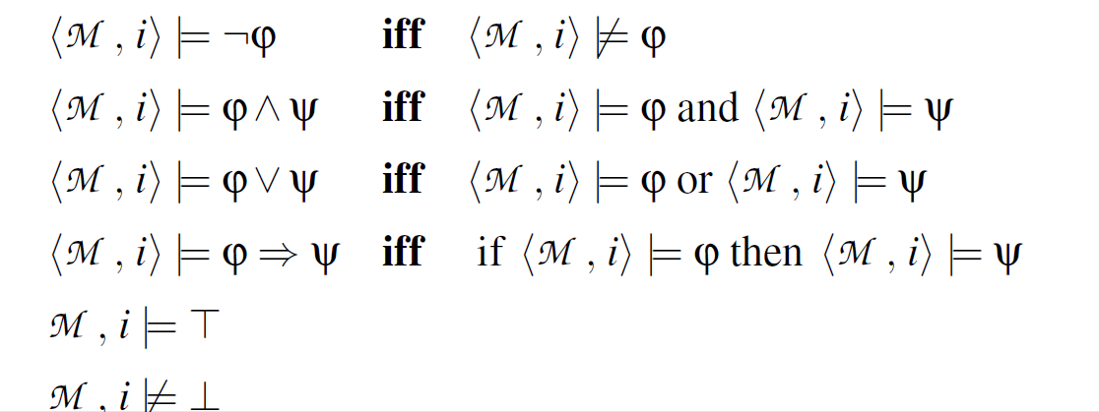
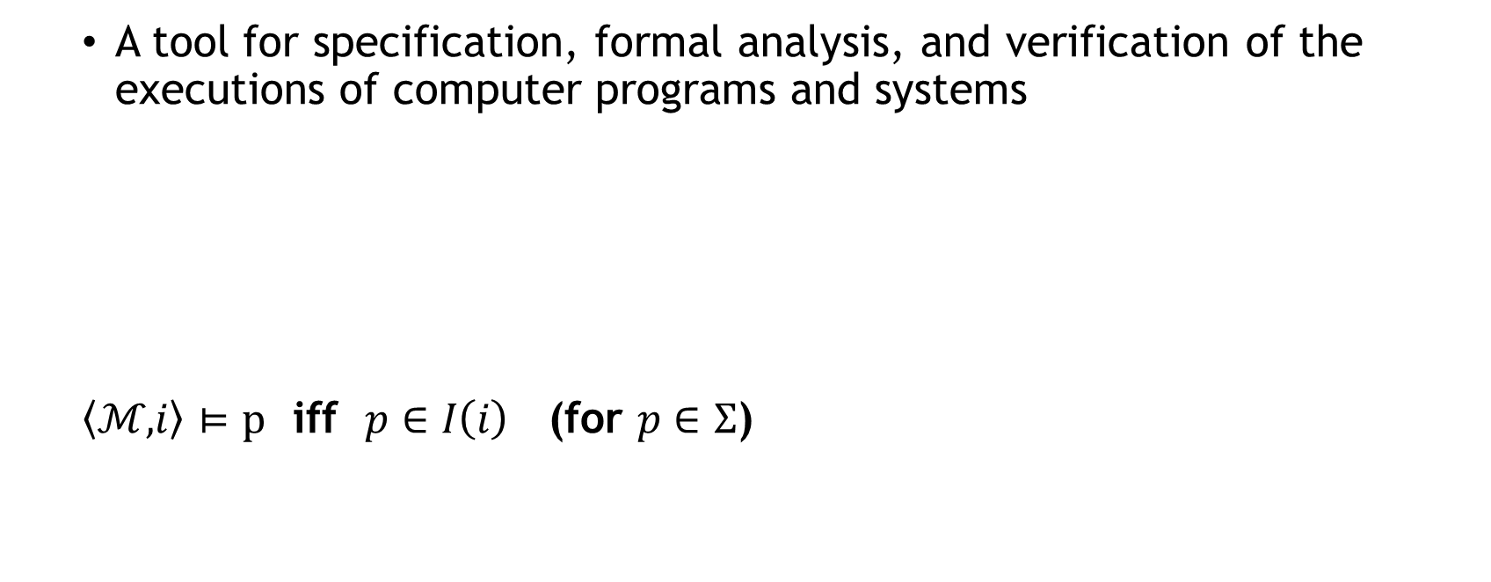
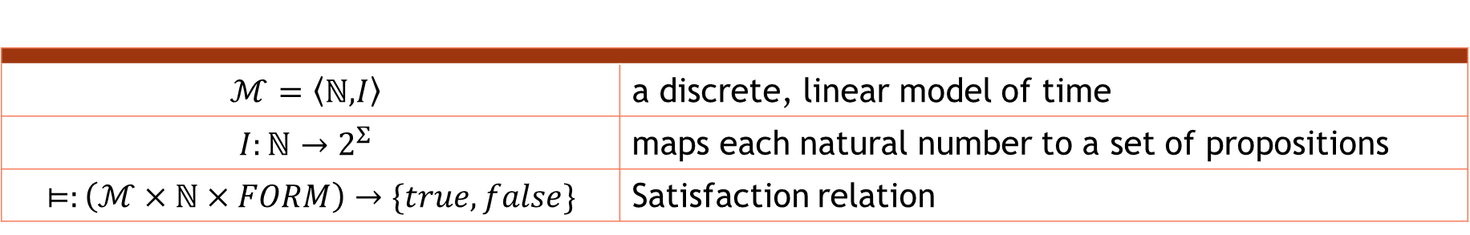
Temporal Semantics
A tool for specification, formal analysis, and verification of the executions of computer programs and systems
$\left\langle ℳ,\right.\left.i\right\rangle$ $⊨p$ iff $p∈I\left(i\right)$ (for $p∈Σ$)
$$ℳ=\left\langle ℕ,\right.\left.I\right\rangle$$ | a discrete, linear model of time
$$I:ℕ→2^{Σ}$$ | maps each natural number to a set of propositions
$⊨:\left(ℳ×ℕ×FORM\right)→\{true,false\}$ | Satisfaction relation

Slide 15
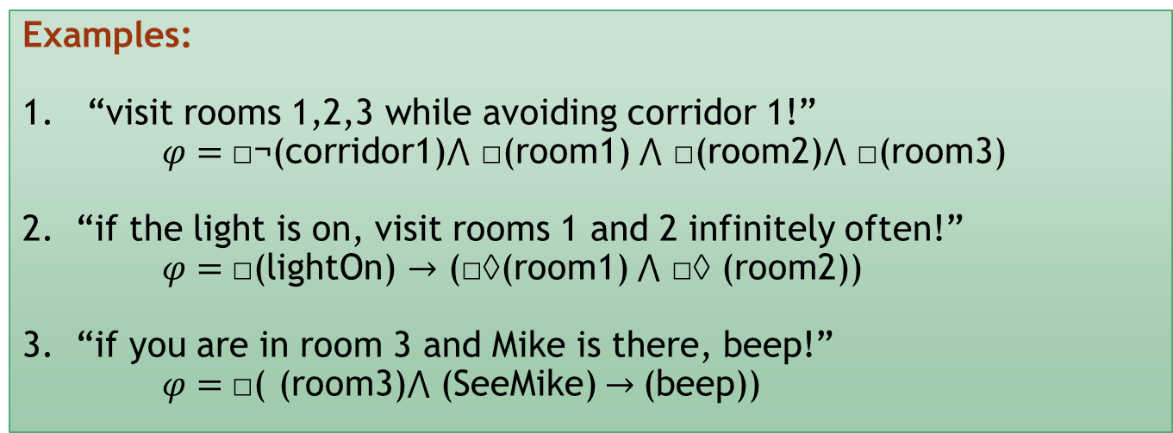
LTL for Robot Task Specifications
Coverage: eventually visit all regions
Sequencing: visit P2 before you go to P3
Avoidance: until you go to P2 avoid P1 and P3
Examples:
“visit rooms 1,2,3 while avoiding corridor 1!”
$φ=$□¬(corridor1)⋀ □(room1) ⋀ □(room2)⋀ □(room3)
2. “if the light is on, visit rooms 1 and 2 infinitely often!”
$φ=$□(lightOn) → (□◊(room1) ⋀ □◊ (room2))
3. “if you are in room 3 and Mike is there, beep!”
$φ=$□( (room3)⋀ (SeeMike) → (beep))

Slide 16
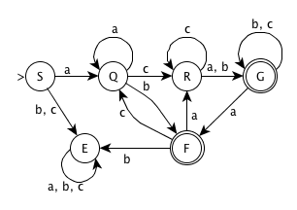
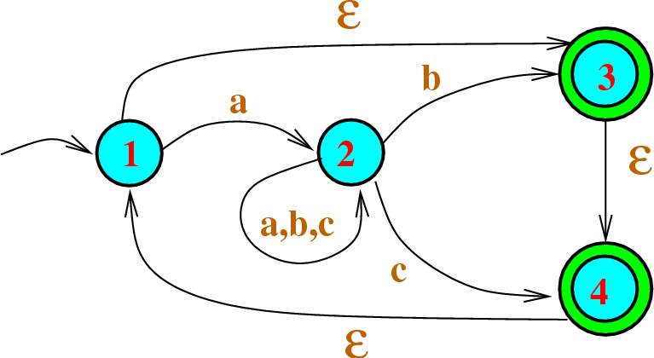
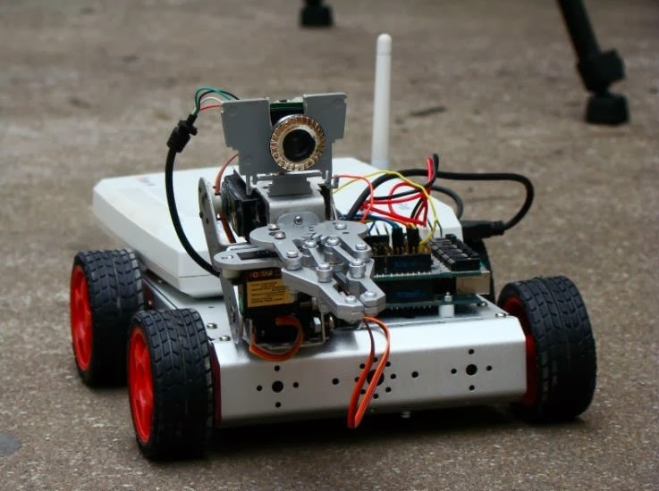
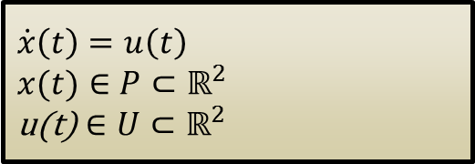
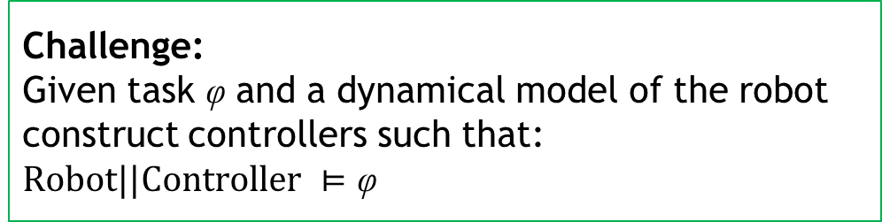
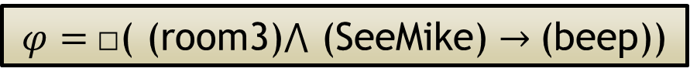
Symbolic Planning
Task
$φ=$□( (room3)⋀ (SeeMike) → (beep))
Abstraction
Hybrid Controller
Challenge:
Given task φ and a dynamical model of the robot construct controllers such that: $Robot||Controller ⊨\text{φ}$
DES supervisor
Robot
$$\dot{x}\left(t\right)=u\left(t\right)$$
$x(t)∈P⊂ℝ^{2}$
$$\text{u}\text{(}\text{t}\text{)}∈U⊂ℝ^{2}$$
Interface

Slide 17

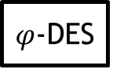
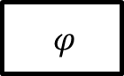

Control Synthesis
Planning
Verification
$$φ$$
$$φ$$
S⊨$φ$?
$φ$-DES
Control System?
Control system S
R-DES
R
R-DES
R

Slide 18
Applying the DES Supervisor to the Robot
P1
P2
Challenge:
DES supervisor tells the robot to go from P1 to P2.
The planner has no idea about the status of robot.
Question:
How to map the high-level task into the continuous controller?
Notes:
Assume you are in room 1 and the planner tells you to go to room2. (discrete action)
The planner has no idea about the status of robot (its position in room 1 and its direction)
So it is not clear how to map the high-level plan into the low-level controller.
So what we need to do is to design a continuous controller based on the dynamics of the system

Slide 19
Bisimulation Equivalency
We have to couple equivalency to specification.
Language equivalency
Bisimulation equivalency
Preserves LTL properties
Continuous system and DES generate the same trajectories
Preserves LTL properties
Continuous system and DES are equivalent in all states (stronger)

Slide 20
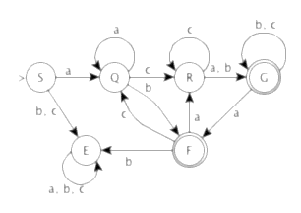
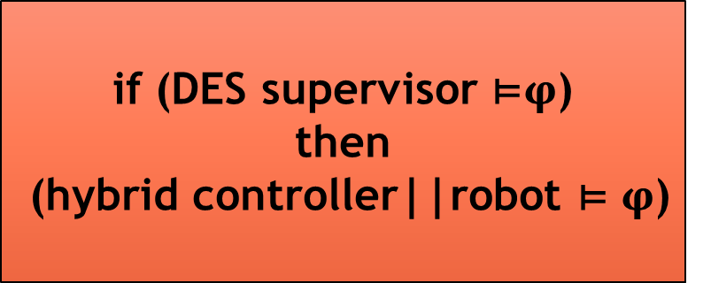

Symbolic Planning
Task
$φ=$□( (room3)⋀ (SeeMike) → (beep))
Bisimulation equivalent
DES supervisor
if (DES supervisor ⊨$φ$)
then
(hybrid controller||robot ⊨ $φ$)
Robot
$$\dot{x}\left(t\right)=u\left(t\right)$$
$x(t)∈P⊂ℝ^{2}$
$$\text{u}\text{(}\text{t}\text{)}∈U⊂ℝ^{2}$$
Interface

Slide 21
Future Work
Avoidance Problem
?
Symbolic Planning

Slide 22
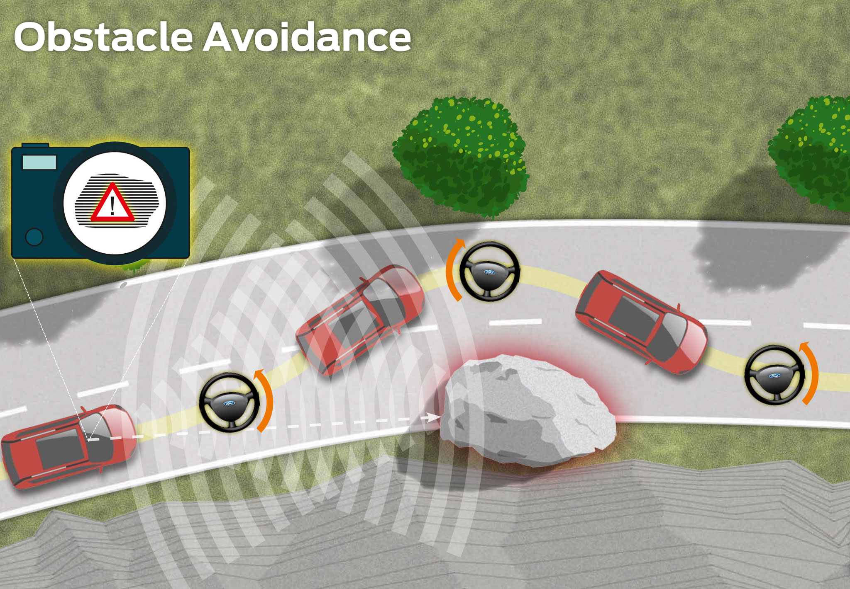
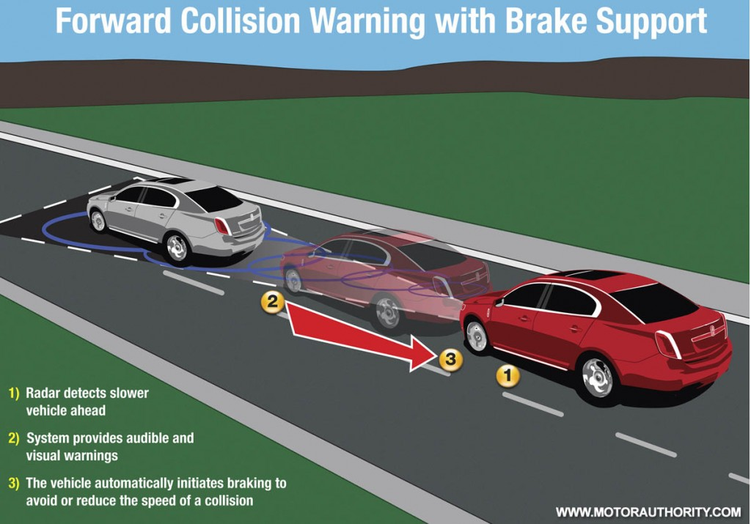
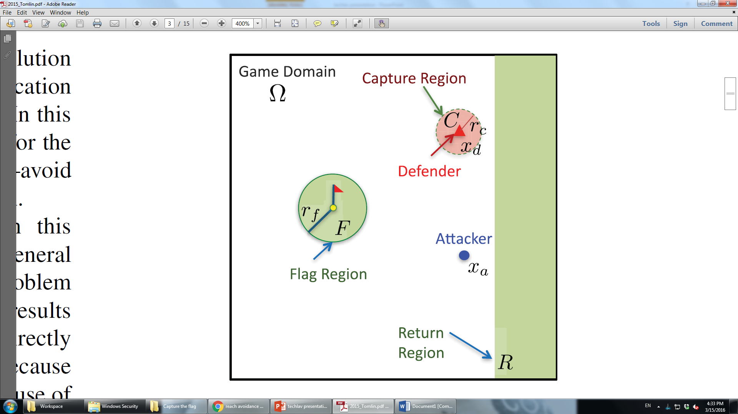

Future Work
Avoidance problem
Obstacle avoidance
Collision avoidance
Reach-avoidance

Slide 23
Future Work
Reach-avoidance
Graph theory
Discrete games
Path planning with obstacle
model-predictive control
Differential game
Partitions the graph into regions that are defended and cleared by a team of pursuers to solve simplified path-planning
Visibility-based pursuit–evasion games: a group of searchers attempt to bring an evader into their field of view, through cooperative coverage of regions
Use the possible future positions of the obstacles as static obstacles, allowing using static planning methods(Certain applications with simple configurations of moving adversarial obstacles,).
Predicts opponent actions so that optimization can be performed for the controlled agents with respect to the assumed opponent behavior
Winning strategies for the opposing agents can be viewed as the solution to a zero-sum differential game. Simple tasks.

Slide 24
1
Formal description of tasks
Efficient computation
Combining reaching problem with avoiding problem
Targeting more complex tasks (sequencing and …)
2
3
4

Slide 25
References
“Hierarchical Hybrid Symbolic Robot Motion Planning And Control”, Ali Karimoddini and Hai Lin, Asian Journal of Control, Vol. 17, No. 1, pp. 23–33, January 2015.
“Temporal Logic Planning and Control of Robotic Swarms by Hierarchical Abstractions”, M. Kloetzer and C. Belta, IEEE TRANSACTIONS ON ROBOTICS, VOL. 23, NO. 2, APRIL 2007.
“Optimal Path Planning under Temporal Logic Constraints”, Stephen L. Smith, Jana Tumova, Calin Belta, Daniela Rus, IEEE/RSJ International Conference on Intelligent Robots and Systems, 2010, Taipei, Taiwan.
“MDP Optimal Control under Temporal Logic Constraints”, Xu Chu Ding Stephen L. Smith Calin Belta Daniela Rus,CDC 2011.
“Automatic Synthesis of Robust Embedded Control Software”, Tichakorn Wongpiromsarn, Ufuk Topcu and Richard M. Murray.
“Flight Demonstrations of Cooperative Control for UAV Teams”, Jonathan How, Ellis King, and Yoshiaki Kuwata, AIAA 3rd "Unmanned Unlimited" Technical Conference, Workshop and Exhibit, 20 - 23 September 2004, Chicago, Illinois.

Slide 26
Thank you ☺
Question?

